Slide 1

AR Workshop Jason Brown, Brent Housen, Kyle Hayward
June 26th, 2018

Slide 2
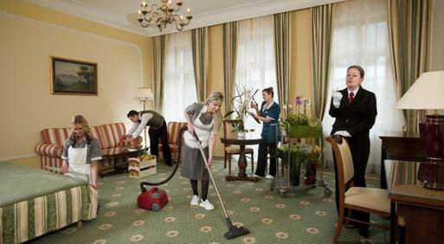
Housekeeping
No meetups over the summer (July and August).
Bathrooms
HoloLens - please don’t break them
Anything else interesting?

Slide 3


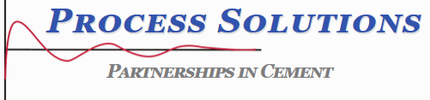

Thanks to Our Sponsors
Are you interested in being a sponsor? Let use know.
Notes:
Postsharp, ReSharper, RebDeBug, Microsoft, Process Solutions, Cloudtrend, Infragistics, Pluralsight, Azure, Windows Phone, Xamarin, Ncover, Microsoft Press, Apress, O’Reilly

Slide 4
Augmented Reality Workshop

Slide 5
Wrap-up
Survey and prize draw! Constructive feedback appreciated.
Next meetup in September.
Contact: info@edmug.net http://edmug.net
Notes:
Don’t forget to thank sponsors. Ask for presenters, etc.

